Slide 1

Cultural Transformation
Microsoft Virtual Internship
Answer

Slide 2
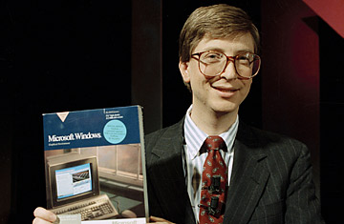

1. Microsoft’s culture transformetion
Microsoft Virtual Internship
Founded in 1975
Goal – a pc in every home
Microsoft logo in 1975

Slide 3


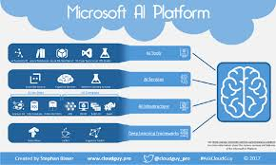
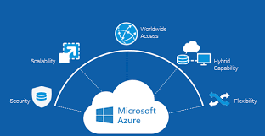
Now Microsoft grown from a start-up to a $110 billion company.
There are now more than 14,000 employees in 120 countries.
Microsoft enables digital transformation for the era of an intelligent cloud and an intelligent edge.
Microsoft mission is to empower every person and every organization on the planet to achieve more.
Microsoft office Microsoft AI Microsoft azure cloud
Microsoft logo present

Slide 4
2. the key elements of the current culture

Slide 5
1. Growth Mindset
Microsoft Virtual Internship
We fundamentally believe that we need a culture founded in a growth mindset. It starts with a belief that everyone can grow and develop; that potential is nurtured, not pre determined; and that anyone can change their mindset. We need to be always learning and insatiably curious.
Learners, always improving, developing value - Knower, genius oriented
Embrace challenge, persist against setbacks, value success of others - Fixed mindset, ignore input,
focus on own success
Celebrate risks, small and large, failure leads to mastery - Cannot risk, cannot fail
Give & get feedback, reflection, iteration - Limit feedback, stay on Track
It’s rare to have a meeting take place, a day, or a week go by where growth mindset learning over knowing doesn’t come up. Growth mindset started as phrase, anchored in a psychological model, and has turned into a way of interacting and doing business.

Slide 6
2. Customer Obsessed
Learning about our customers and their businesses with a beginner’s mind and then bring solutions that meet their needs. Microsoft will be insatiable in our desire to learn from the outside and bring it into Microsoft, while still innovating to surprise and delight our users.
Microsoft mission is empower the every person and organization through our technology invitations.
Internally driven
Feature focus
Active listeners, using customer feedback early and often throughout lifecycle
Decision drivers: project plans, politics, intuition

Slide 7
3. Diversity and Inclusion
The world is diverse. We will better serve everyone on the planet by representing everyone on the planet.
Mycroft is open to learn biases and changing behaviour so it tap to collect the power
As a result idea and product are better also customer served better
Aware of diversity - Celebrating and accountable for diversity
Acknowledging differences - Value and enable differences
View diversity as a narrow conversation - Inclusive behaviours and attitudes are core
Diversity is an activity - Diversity and Inclusion is a commitment - a key business priority

Slide 8
4. One Microsoft
Microsoft is a family of individuals united by a single, shared mission. It’s our ability to work together that makes our dreams believable and, ultimately, achievable. We will build on the ideas of others and collaborate across boundaries to bring the best of Microsoft to our customers as one. We are proud to be part of team Microsoft.
Connected, working together for shared goals
Information is powerful transparent and share openly
Value contributions to and with others we are better together
optimize for Team Microsoft

Slide 9
5. Making a difference
Making a difference isn’t just a result or an outcome of culture. We believe each of us can improve at making a difference by applying a growth mindset to discovering our purpose and working on things that ladder-up to something larger than ourselves. We truly believe we have an opportunity to change the world we live in.
We stand invade of what humans dare to achieve and are motivated every day to empower others to do more and achieve more through our technology and innovation.
Bold ambitions
Value purpose and impact achievement and effect
Simplicity, clarity empowerment
Microsoft changes the world

Slide 10
3.inspires about Microsoft’s culture
Microsoft Virtual Internship
Leadership principles - Culture starts at the top, but it shouldn’t stay there. As you’ve seen we started at the top with a leader-led effort but that isn’t self-sustaining.
Create clarity – It Synthesize the complex and Ensure shared understanding that Define a course of action
Generate energy- It Inspire optimism, creativity, and growth and Create an environment where everyone does their best work also Build organizations that are stronger tomorrow than today
Deliver success - It Drive innovation that people love to Be boundary-less in seeking solutions and Tenaciously pursue the right outcomes
The diversity and inclusion mark a growth in mindset of the people working here and also differentiates Microsoft from other organizations. I would love to become a part of this culture and reflect it in my action ahead

